Slide 1




DIGITAL LITERACY
SKILLS
INTERMEDIATE USERS

Slide 2

Module 4
Content

Slide 3

2
Unit 2: Integrating and
re-elaborating digital content

Slide 4
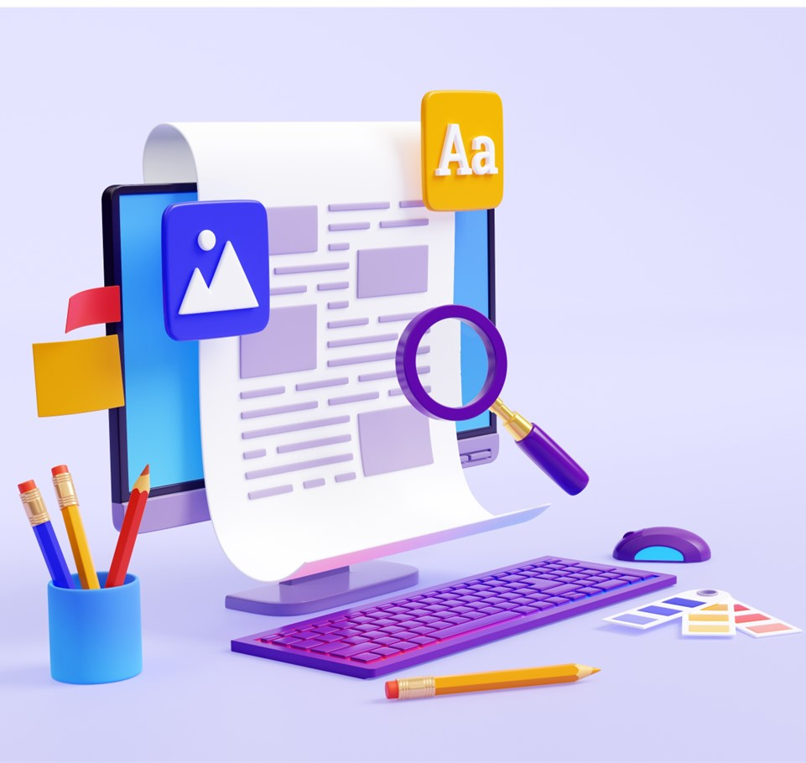
Content creation
Content creation and integration is to modify, refine and integrate new information and content into an existing content and resources to create new, original and relevant content and knowledge.
You should ask: Who am I trying to reach?
Start by carrying out research to ensure you are making the right choice.

Slide 5

Storing your content
You should know the safest way save your content for ease of access but also security.
Cloud file sharing can be a useful platform, which allows you to access content from any device.
Discover Dropbox, Google Drive, and One Drive and change the way you share your materials.

Slide 6
Skills to practise
Apply basic formatting
Watch the video about footnotes: https://support.microsoft.com/en-us/office/insert-footnotes-and-endnotes-61f3fb1a-4717-414c-9a8f-015a5f3ff4cb
Watch this video about content tables: https://support.microsoft.com/en-au/office/insert-a-table-of-contents-882e8564-0edb-435e-84b5-1d8552ccf0c0
Your facilitator will give you a text document.
Change the font style and size.
Create headings in the document.
Add a contents table at the start of the document.
Insert a footnote at the bottom of each page.

Slide 7
All back covers should include
contact information of the section
producing the work.
© United Nations Children’s Fund (UNICEF) [month and year of publication]

